Slide 1
Local Socket & Remote Socket In advance
Author: Tong Hung Son
Nguyen Van Hung
Email: son.tong@lge.com
hung6.nguyen@lge.com

Slide 2
Content
Definition of Local Socket, Remote Socket
Comparison between Stream Socket and Datagram Socket
Multiple client, multiplexing
Tools, demo

Slide 3
Definition of Local Socket, Remote Socket
Definition of Local Socket, Remote Socket
Comparison between Stream Socket and Datagram Socket
Multiple client, multiplexing
Tools, demo

Slide 4
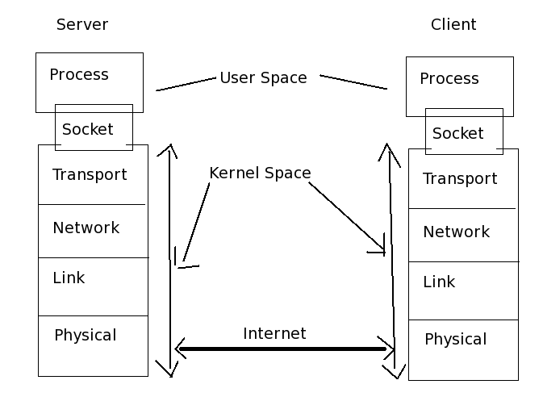
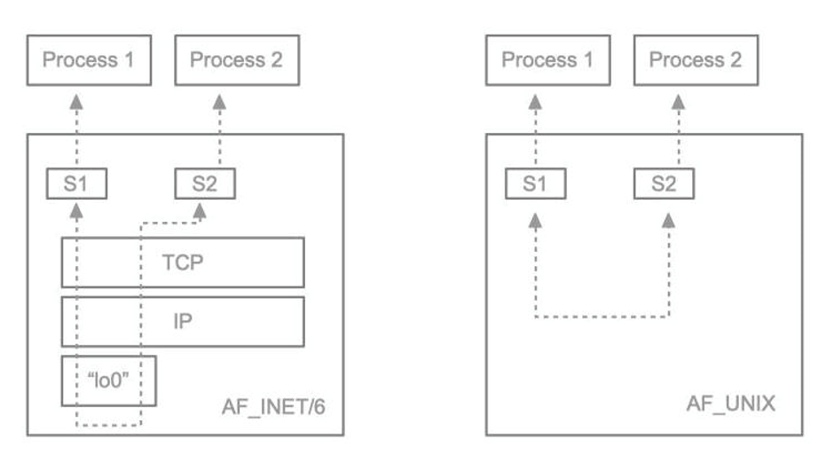
Socket
A socket is a communication mechanism that allows client/server systems to be developed either locally, on a single machine, or across networks
Examples of IPC over Socket
Single machine
Single machine
Between machines

Slide 5
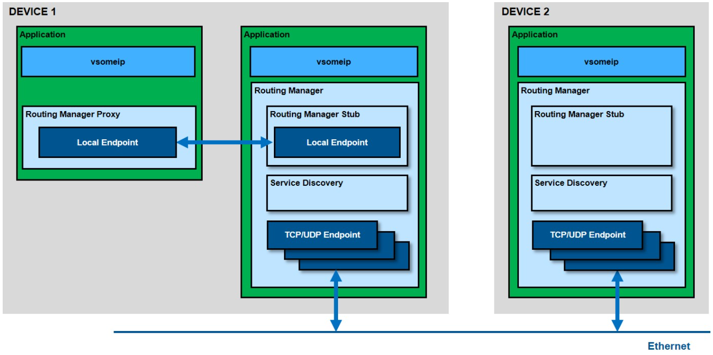
Socket with SOME/IP traffic
SOME/IP is on Application layer based on Socket communication (TCP/IP)
1
2
3

Slide 6
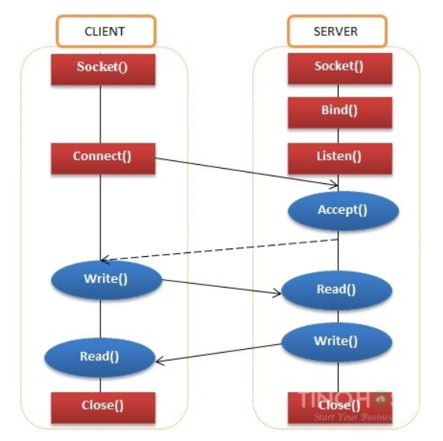
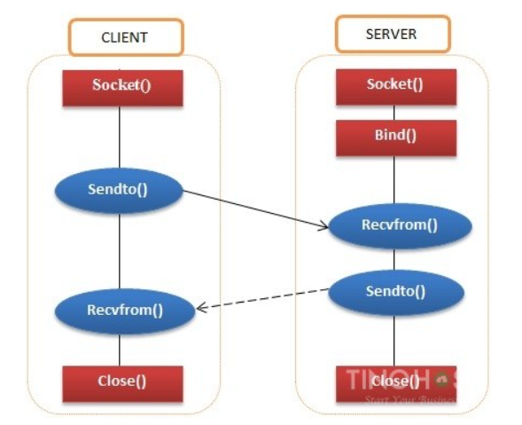
Datagram Socket & Stream Socket in programming
Datagram
Stream

Slide 7
Local socket
Definition: A UNIX socket, AKA Unix Domain Socket, is an inter-process communication mechanism that allows bidirectional data exchange between processes running on the same machine.
A UNIX domain socket is bound to a file path
Use: IPC on a machine, someip on local machine
Note: Datagram Socket Client must bind file path, Stream Socket Client don’t have to bind file path

Slide 8
Local socket Implementation
Server and Client use local file for communication
AF_UNIX socket type
Example code: Local Diagram Socket Server - Client
# define SERVER_SOCK_FILE "server.sock"
// Creating SERVER socket file descriptor
server_sockfd = socket(AF_UNIX, SOCK_DGRAM, 0);
// Name the socket then bind
server_address.sun_family = AF_UNIX;
strcpy(server_address.sun_path, SERVER_SOCK_FILE);
unlink(SERVER_SOCK_FILE);
bind(server_sockfd, (struct sockaddr *)&server_address, sizeof(server_address))
// Receive
recvfrom(server_sockfd, (char *)buffer, MAXLINE,
MSG_WAITALL, ( struct sockaddr *) &client_address,
&len);
// Send
sendto(client_sockfd, (const char *)client_msg, strlen(client_msg), MSG_CONFIRM, (struct sockaddr *)&server_address, sizeof(server_address));
# define CLIENT_SOCK_FILE "client.sock“
# define SERVER_SOCK_FILE "server.sock"
// Creating CLIENT socket file descriptor
client_sockfd = socket(AF_UNIX, SOCK_DGRAM, 0)
// Name the socket then bind
client_address.sun_family = AF_UNIX;
strcpy(client_address.sun_path, CLIENT_SOCK_FILE);
unlink(CLIENT_SOCK_FILE);
bind(client_sockfd, (struct sockaddr *)&client_address, sizeof(client_address));
// Name the socket
server_address.sun_family = AF_UNIX;
strcpy(server_address.sun_path, SERVER_SOCK_FILE);
// Send
sendto(client_sockfd, (const char *)client_msg, strlen(client_msg),
MSG_CONFIRM, (const struct sockaddr *)&server_address,
sizeof(server_address));
// Receive
recvfrom(client_sockfd, (char *)buffer, MAXLINE,
MSG_DONTWAIT, (struct sockaddr *)&server_address, &len);

Slide 9
Remote Socket
Definition: IP sockets (especially TCP/IP sockets) are a mechanism allowing communication between processes over the network. In some cases, you can use TCP/IP sockets to talk with processes running on the same computer (by using the loopback interface)
A remote socket is bound to a unique IP address and port number
Use: Communication over network (http, ssh, ftp, ...), vsomeipd for IP based communication between devices
Note: Socket Client don’t have to bind to an address. In that case, the bind is implicit done in kernel side.

Slide 10
Remote socket Implementation
Server and Client use IP address for communication
AF_INET socket type
Example code: Remote Datagram Socket Server - Client
# define SERVER_IP_ADDRESS "192.168.56.104"
# define SERVER_PORT 8080
// Creating SERVER socket file descriptor
server_sockfd = socket(AF_INET, SOCK_DGRAM, 0)
// Name the socket then bind
server_address.sin_family = AF_INET; // IPv4
server_address.sin_addr.s_addr = inet_addr(SERVER_IP_ADDRESS);
server_address.sin_port = htons(SERVER_PORT);
bind(server_sockfd, (struct sockaddr *)&server_address, sizeof(server_address))
// Receive
recvfrom(server_sockfd, (char *)buffer, MAXLINE,
MSG_WAITALL, ( struct sockaddr *) &client_address,
&len);
// Send
sendto(client_sockfd, (const char *)client_msg, strlen(client_msg), MSG_CONFIRM, (struct sockaddr *)&server_address, sizeof(server_address));
# define SERVER_IP_ADDRESS "192.168.56.104"
# define SERVER_PORT 8080
# define CLIENT_IP_ADDRESS "192.168.56.102"
# define CLIENT_PORT 5000
// Creating CLIENT socket file descriptor
client_sockfd = socket(AF_INET, SOCK_DGRAM, 0)
// Name the server socket
server_address.sin_family = AF_INET;
server_address.sin_port = htons(SERVER_PORT);
server_address.sin_addr.s_addr = inet_addr(SERVER_IP_ADDRESS);
// Name the socket then bind (OPTINAL)
client_address.sin_family = AF_INET;
client_address.sin_port = htons(CLIENT_PORT);
client_address.sin_addr.s_addr = inet_addr(CLIENT_IP_ADDRESS);
bind(client_sockfd, (const struct sockaddr *)&client_address,
sizeof(client_address))
// Send
sendto(client_sockfd, (const char *)client_msg, strlen(client_msg),
MSG_CONFIRM, (const struct sockaddr *)&server_address,
sizeof(server_address));
// Receive
recvfrom(client_sockfd, (char *)buffer, MAXLINE,
MSG_DONTWAIT, (struct sockaddr *)&server_address, &len);

Slide 11
Comparison between Stream Socket and Datagram Socket
Definition of Local Socket, Remote Socket
Comparison between Stream Socket and Datagram Socket
Multiple client, multiplexing
Tools, demo

Slide 12
Stream Socket & Datagram Socket
Stream Socket | Datagram Socket
SOCK_STREAM type | SOCK_DGRAM type
Sequenced, reliable, connection-based two-way byte stream | No guarantee that the message will be delivered or that messages won’t be reordered
In the network (AF_INET sockets), this type of communication is provided by TCP protocol | In the network (AF_INET sockets), this type of communication is provided by UDP protocol

Slide 13
Stream & Datagram in Local Socket
Comparison:
UNIX domain datagram sockets are always reliable and don't reorder datagrams (since Linux 2.6.4)
Performance should be the same since both types just go through local in-kernel memory
Just the buffer management is different
Datagram socket, on the other hand, does preserve these boundaries - one write by the sender always corresponds to one read by the receiver
Stream socket does not preserve message boundaries
Usage:
If application protocol has small messages with known upper bound on message size, you are better off with Datagram socket since that's easier to manage
If your protocol calls for arbitrary long message payloads, or is just an unstructured stream (like raw audio or something), then pick Stream socket and do the required buffering

Slide 14
Stream & Datagram in Remote Socket (part 1)
Basis | Transmission control protocol (TCP) | User datagram protocol (UDP)
Type of Service | TCP is a connection-oriented protocol | UDP is the Datagram-oriented protocol
Reliability | TCP is reliable as it guarantees the delivery of data to the destination. | The delivery of data to the destination cannot be guaranteed in UDP.
Error checking mechanism | TCP provides extensive error-checking mechanisms. It is because it provides flow control and acknowledgment of data. | UDP has only the basic error checking mechanism using checksums.
Acknowledgment | An acknowledgment segment is present. | No acknowledgment segment.
Sequence | packets arrive in order at the receiver | There is no sequencing of data in UDP
Speed | TCP is comparatively slower than UDP | UDP is faster, simpler, and more efficient than TCP
Retransmission | Retransmission of lost packets is possible | There is no retransmission of lost packets in

Slide 15
Stream & Datagram in Remote Socket (part 2)
Basis | Transmission control protocol (TCP) | User datagram protocol (UDP)
Header Length | TCP has a (20-60) bytes variable length header | UDP has an 8 bytes fixed-length header.
Weight | TCP is heavy-weight. | UDP is lightweight.
Handshaking Techniques | Uses handshakes such as SYN, ACK, SYN-ACK | It’s a connectionless protocol i.e. No handshake
Broadcasting | TCP doesn’t support Broadcasting. | UDP supports Broadcasting.
Protocols | TCP is used by HTTP, HTTPs, FTP, SMTP and Telnet. | UDP is used by DNS, DHCP, TFTP, SNMP, RIP, and VoIP.
Stream Type | The TCP connection is a byte stream. | UDP connection is message stream.
Overhead | Low but higher than UDP. | Very low

Slide 16
Multiple client, multiplexing
Definition of Local Socket, Remote Socket
Comparison between SOCK_DGRAM and SOCK_STREAM
Multiple client, multiplexing
Tools, demo

Slide 17
Multi-clients with multi-workers
Implementation in Server side
Assign requests to workers
Usage: Make server side work fast
Multi-process Server
Child process processes request from Client
In Linux, use “fork” to create a copy code of server for child process
Multi-thread Server
A thread processes request from Client
Thread pool to manage number of threads

Slide 18
Multiplexing with “non-blocking” call
System calls like accept, read, write use file descriptor (fd) to communicate with through the socket are called “blocking” calls
“Blocking” calls: whenever your program calls one of those functions, your program will be blocked until it gets the intended interrupt
Then the idea of “non-blocking” calls comes into place -> select() is one of the widely used.
Usage: Make server, client work without system call blocking

Slide 19
Tools, demo
Definition of Local Socket, Remote Socket
Comparison between SOCK_DGRAM and SOCK_STREAM
Multiple client, multiplexing
Tools, demo

Slide 20
Tools
Tools: Wireshark, netstat, tcpdump, …
Demo:
Local Stream Socket
Remote Stream Socket
Multi-process TCP Server
Multi-thread TCP Server
Multiplexing TCP Server

Slide 21
Thank you for watching

